Slide 1
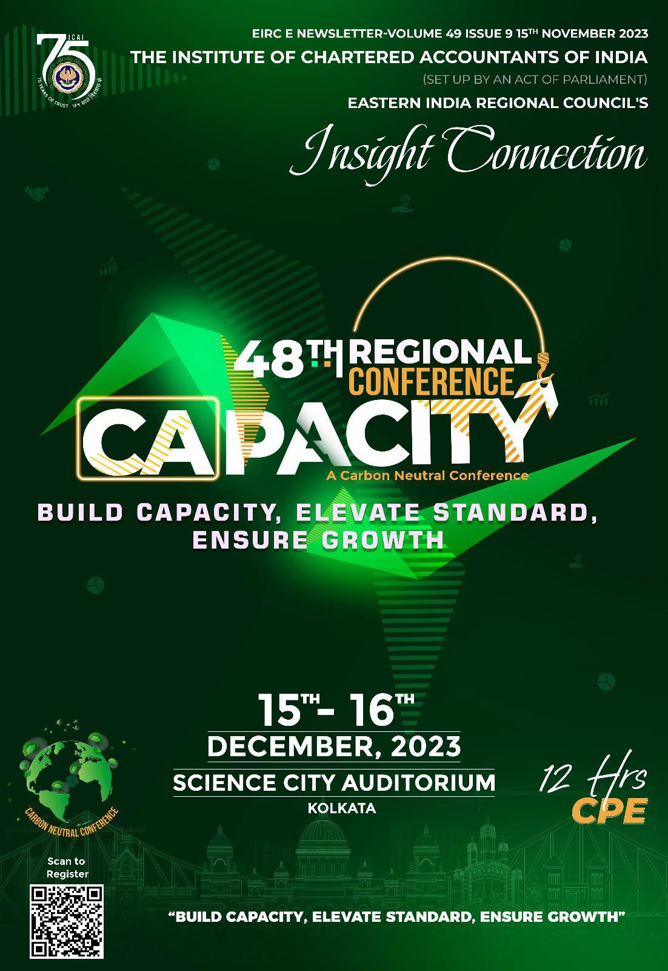

Slide 2
THE INSTITUTE OF CHARTERED ACCOUNTANTS OF INDIA (Set up by an Act of Parliament)
Navigating The Complexity of Income Tax Provisions
And Start-ups and Income tax Provisions
EIRC of the ICAI

Slide 3
Navigating The Complexity of Income Tax Provisions

Slide 4
Section 2(15) - Education
Gujarat Council of Science City
[2023] 150 taxmann.com 310 (Ahmedabad - Trib.)
Activities of running science museum - Not meet definition of education
Definition of Education - New Noble Educational Society v. Chief CIT [2022] 143 taxmann.com 276
However, were in nature of general public utility activities in terms of section 2(15)
Asstt. CIT (Exemptions) v. Ahmedabad Urban Development Authority [2022] 143 taxmann.com 278

Slide 5
Section 40(a)(ia) - Disallowance
Khedut Foods and Feeds P. Ltd. V. DCIT
2022 (12) TMI 636 - ITAT RAJKOT
Disallowance u/s 40(a)(ia) for non-deduction of tax at source (TDS) - Assessee in default - Assessee has paid interest u/s 201(1A) for non-deduction/short deduction of tax - the Assessee having paid the interest, the Assessee cannot be construed as an Assessee in default. Assessee enclosed Form No. 26A.
Therefore, the provision of Section 40(a)(ia) cannot be applied in assessee’s case.

Slide 6
Section 44AD - EIS
Reporting of 8% (6% for banking channel receipts) of turnover / gross receipts.
P&L – Turnover Rs. 80 L. Provit Rs. 30 L.
ITR – Rs. 8 L.
Can cash expenses disallowed u/s. 40A(3)
Can AO assess income @ Rs. 30 L.
Effect of Assessee buying Rs. 25 L. gold

Slide 7
Section 54(2) - Exemption
Venkata Dilip Kumar, Kartha-HUF Vs CIT [Madras High Court) Appeal Number : W.P.No.16249 of 2018 Dated : 05/11/2019
Amount not utilised for the purchase / construction before due date of furnishing the ITR under sec. 139, shall be deposited before furnishing such return not later than ITR due date applicable under section 139(1) in an account in any specified bank or institution.
Court: While the compliance of requirement under Section 54(1) is mandatory and if complied, has to be construed as substantial compliance to grant the benefit of deduction, the compliance of requirement under Section 54(2) could be treated only as directory in nature

Slide 8
Section 64(1A) - Clubbing
SIBI JOY [2023] 150 taxmann.com 524 (Kerala)
Interest income arising in hands of a minor should be added to parent's total income under section 64(1A) for purpose of taxation.
Section 145
Cumulative Interest Debentures
Loss sustained
Ashok Kumar Vs. CIT (1996) 217 ITR 251 (AII): where a gift has been made, prior to solemnisation of the marriage, to would be wife, the provisions of Section 64(1)(iv) cannot be applicable on any income arises form that gifted property.

Slide 9
Section 220 – Recovery
Neo Structo Constructions P. Ltd.
[2023] 292 taxmann 162 (Guj) (HC)
Appeal pending before CIT(A). Stay petition filed.
65% of total demand was auto-adjusted
Assessee applied for refund beyond 20%
HC – Revenue directed to refund amount in excess of 20% of demand adjusted.

Slide 10
Section 276CC - Prosecution
Suresh Kumar Agarwal
[2023] 146 taxmann.com 27 (Jharkhand)
Where Commissioner launched prosecution under section 276CC against assessee for filing return after a delay, in view of fact that assessee had filed belated return and also deposited amount of tax along with interest for delay which was accepted by authority concerned, no sentence could be imposed under section 276CC

Slide 11
Start-ups and Income tax Provisions

Slide 12
Section 80-IAC
(1) Where the gross total income of an assessee, being an eligible start- up, includes any profits and gains derived from eligible business, there shall be a deduction of an amount equal to 100% of the profits and gains derived from such business for three consecutive assessment years.
The Oyher conditions should be observed.
(2) The deduction specified in sub-section (1) may, at the option of the assessee, be claimed by him for any 3 consecutive assessment years out of 10 years beginning from the year in which the eligible start-up is incorporated.

Slide 13
Part A: Start-Up Taxation
Ex. (ii) "eligible start-up” means company or LLP engaged in eligible business which fulfils the following conditions, namely:—
(a) it is incorporated on or after the 1st day of April, 2016 but before the 1st day of April, 2024;
(b) the total turnover of its business does not exceed Rs. 100 cr in the previous year relevant for which deduction is claimed; and
(c) it holds a certificate of eligible business from the Inter-Ministerial Board of Certification as notified in the Official Gazette by the Central Government;
Change of hands of Undertaking V transfer of ownership of Co

Slide 14
Part A: Start-Up Taxation
Ex. (i) "eligible business" means a business carried out by an eligible start-up engaged in innovation, development or improvement of products or processes or services or a scalable business model with a high potential of employment generation or wealth creation

Slide 15
Part A: Start-Up Taxation
Conditions:
it is not formed by splitting up, or the reconstruction, of a business already in existence. Exception: the assessee of the business of any such undertaking - section 33B
It is not formed by the transfer to a new business of machinery or plant previously used for any purpose.
Exceptions: (i) Any machinery or plant which was used outside India by any person other than the assessee – not used in India, Imported in India and No Depreciation Claim (ii) Up to 20% previously used allowed

Slide 16
Part A: Start-Up Taxation
Computed as if such eligible business were the only source of income of the assessee during the previous year relevant to the initial assessment year and to every subsequent assessment year
Accounts have been audited by an accountant
Transactions with AE are made at the market value of such goods or services at the arm's length
Deduction to the extent of such profits and gains shall not be allowed under any other provisions of this Chapter VIA - (C)
‘Arrangements’ - the amount of profits as may be reasonably deemed to have been derived therefrom

Slide 17
Section 43B
THE MICRO, SMALL AND MEDIUM ENTERPRISES
DEVELOPMENT ACT, 2006
Sec, 15. Liability of buyer to make payment.—Where any supplier supplies any goods or renders any services to any buyer, the buyer shall make payment therefor on or before the date agreed upon between him and the supplier in writing or, where there is no agreement in this behalf, before the appointed day:
Provided that in no case the period agreed upon between the supplier and the buyer in writing shall exceed forty-five days from the day of acceptance or the day of deemed acceptance.
Sec 2 (b) “appointed day” means the day following immediately after the expiry of the period of fifteen days from the day of acceptance or the day of deemed acceptance of any goods or any services by a buyer from a supplier.

Slide 18
Section 56(2)(viib) - Premium
Section 56(2)(viib) provides that if unquoted shares are issued at a premium by a closely held company, the excess of premium over the fair market value of the shares shall be taxable as income from other sources in the hands of the company.
However, where an eligible start-up fulfills the conditions prescribed in Notification No. GSR 127 (E) [F.NO.5 (4)/2018-SI], dated 19-2-2019, provisions of this section will not apply.
CBDT 13/2019 – dt. 5 March 2019
Section 56(2)(viib) inapplicable to Start-Up

Slide 19
Section 79 – Loss
Conditions to set off the carried forward losses. Where substantial change has happened in the voting power of co
Eligible start-up - losses can be carried forward on the satisfaction of any of the two conditions specified below:
Continued 51% shareholding –
In the year of set-off of losses, at least 51% of voting power is beneficially held by the same persons who held them as on the last day of the year in which loss was incurred; or
Continued 100% shareholders with the same voting rights –
100% of shareholders, on the last day of the previous year in which loss was incurred, should continue to hold the same shares on the last day of the previous year in which loss is to be set-off

Slide 20
Section 54GB – Capital Gain
Section 54GB of the Act allowed exemption on capital gains arising from transfer of residential property being a house or a plot of land owned by an Individual or HUF subject to compliance of certain conditions viz:
Net consideration arising out of such transfer is utilised for subscription in the equity shares of an eligible start-up fulfilling prescribed conditions; and
Such eligible start-up has utilised this amount for purchase of new asset within one year from the date of subscription in equity shares by assessee.

Slide 21
Section 192 – Salary TDS
ESOP Income section 17(2)(vi) Salary TDS shall deduct or pay, as the case may be, tax on such income within fourteen days —
(i) after the expiry of forty-eight months from the end of the relevant assessment year; or
(ii) from the date of the sale of such specified security or sweat equity share by the assessee; or
(iii) from the date of the assessee ceasing to be the employee of the person,
whichever is the earliest, on the basis of rates in force for the financial year in which the said specified security or sweat equity share is allotted or transferred.

